Slide 1
Marketing in
The Off Season

Slide 2
Sponsored by

Slide 3
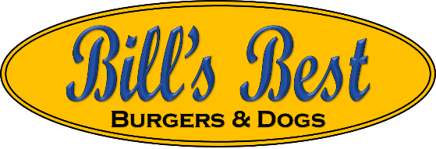
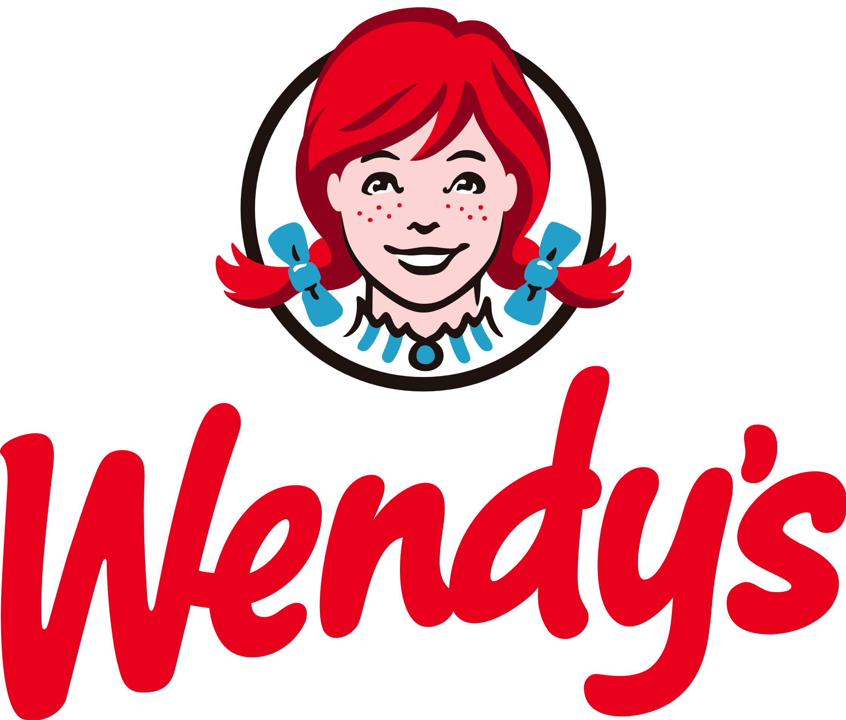
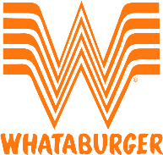
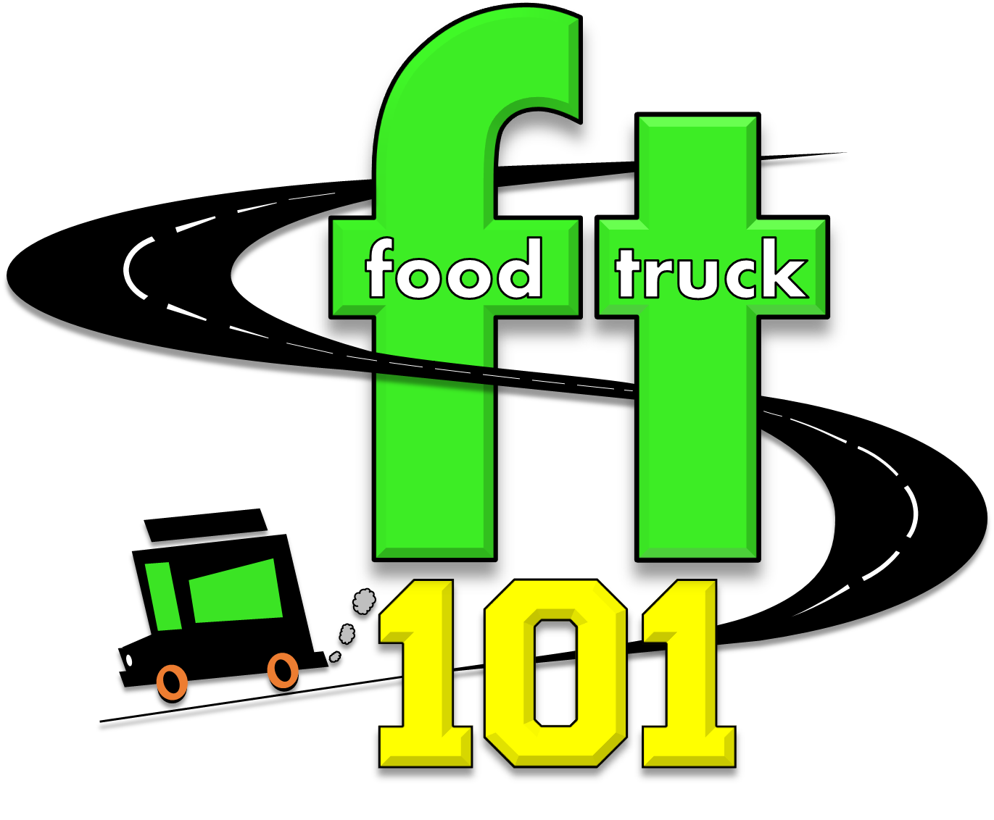
Street vendor
Author
Corporate Trainer
Executive Director
Bill Moore

Slide 4
Analyze Past Performance and Market Trends
Review Sales Data: Look at the previous off-seasons to identify what worked and what didn’t.
Guest Feedback: Before the slow season ask, “Do you think staying open would be worth it for me this winter?” then follow up with “Can I count on you?”
Competitor Analysis: Observe how competitors have adapted to the off-season, noting any gaps in the market that you could fill.

Slide 5
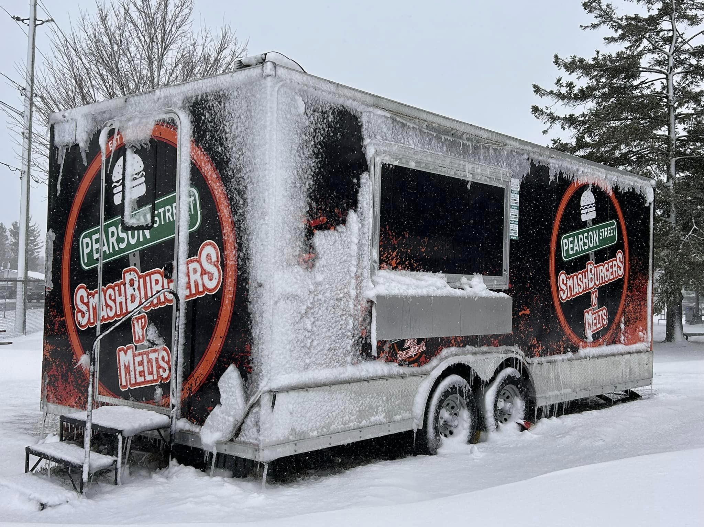
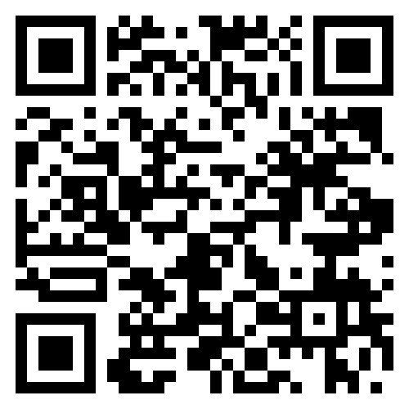
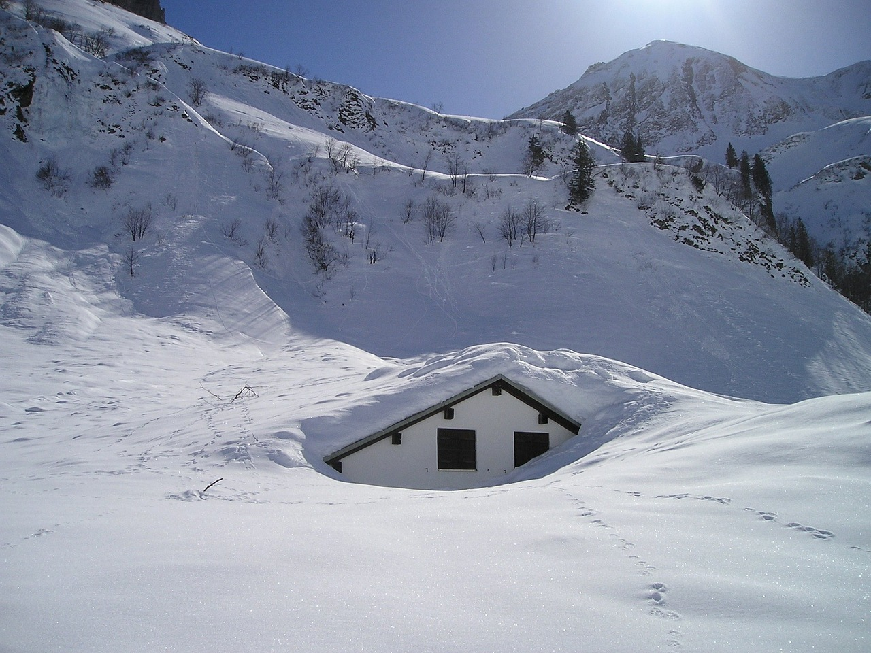
Analyze Past Performance and Market Trends
Review Sales Data: Look at the previous off-seasons to identify what worked and what didn’t.
Guest Feedback: Before the slow season ask, “Do you think staying open would be worth it for me this winter?” then follow up with “Can I count on you?”
Competitor Analysis: Observe how competitors have adapted to the off-season, noting any gaps in the market that you could fill.

Slide 6
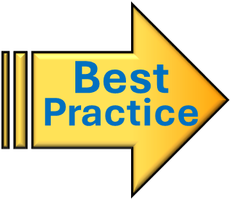
Analyze Past Performance and Market Trends
Review Sales Data: Look at the previous off-seasons to identify what worked and what didn’t.
Guest Feedback: Before the slow season ask, “Do you think staying open would be worth it for me this winter?” then follow up with “Can I count on you?”
Competitor Analysis: Observe how competitors have adapted to the off-season, noting any gaps in the market that you could fill.
Break Even Should Include Setting Aside Money for the Off Season

Slide 7
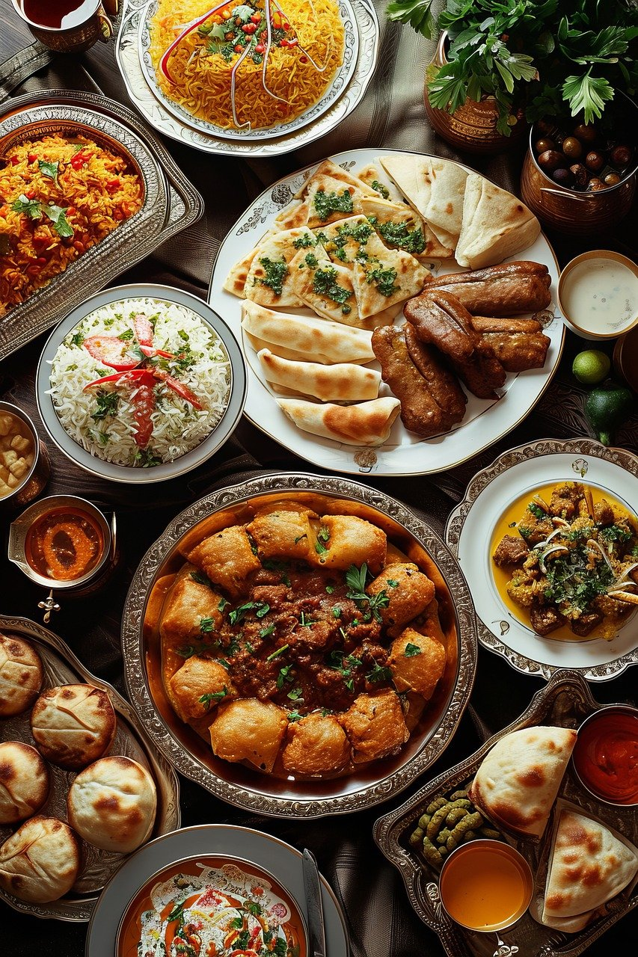
Seasonally Redefine Your Guest Pool
Segmentation: Identify which guests are most likely to engage with your food truck during the off-season.
Guest Needs: Adjust your marketing to address the seasonal needs and preferences of your target audience.
meal prep
party catering

Slide 8
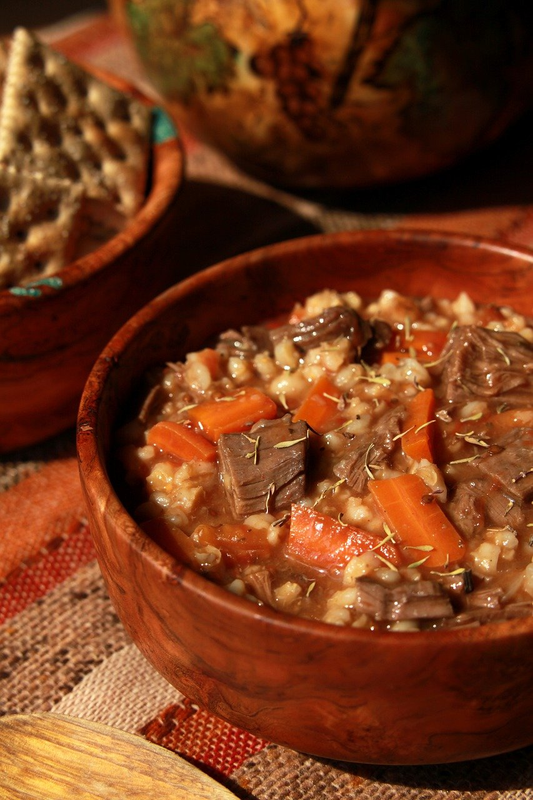
Adapt Your Offerings
Menu Adjustments: Tailor your menu to include seasonal ingredients and comfort foods that appeal during cooler weather.
Special Promotions: Offer holiday-themed specials or limited-time offers to create urgency and attract guests.

Slide 9
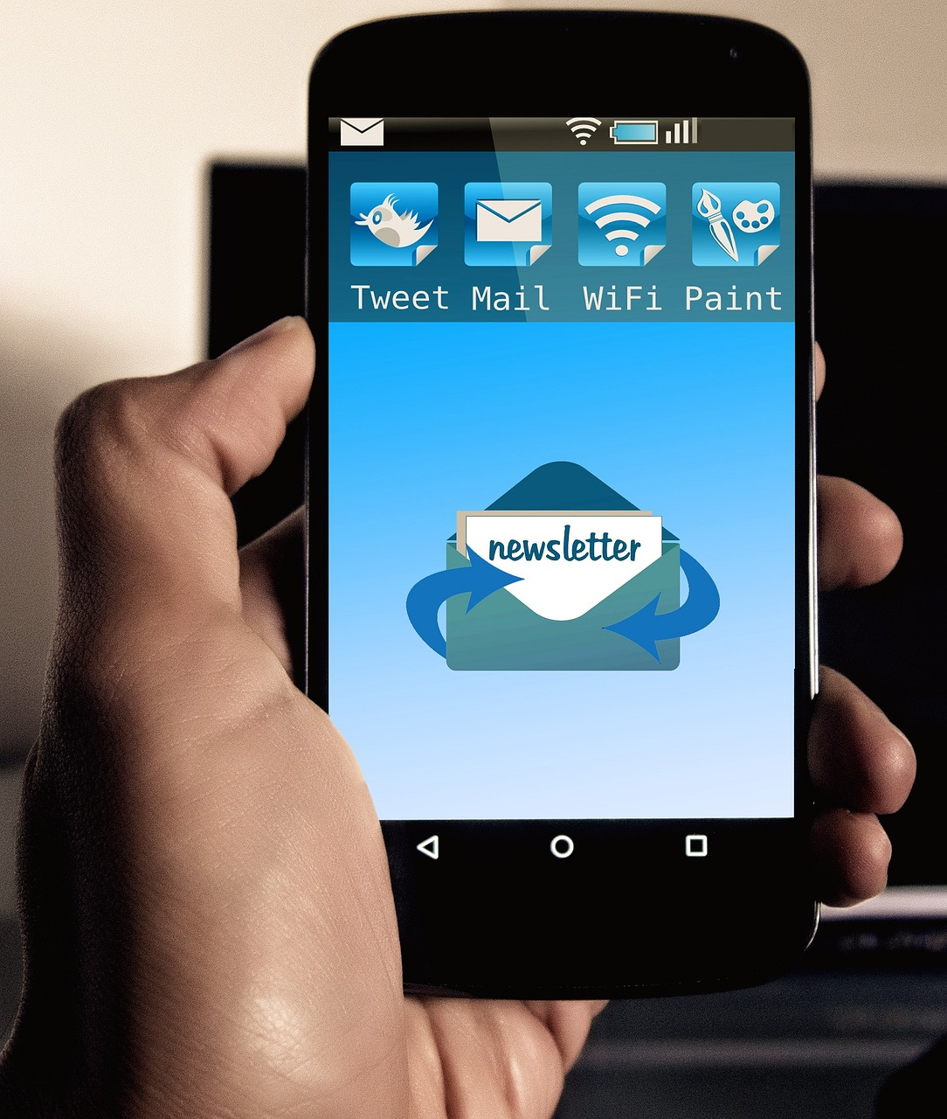
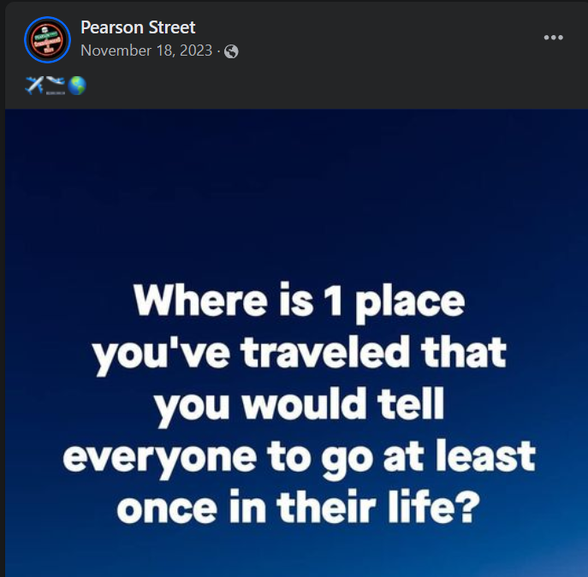
Ramp Up Engagement Tactics
Email Marketing: Send regular newsletters to keep your brand top-of-mind, featuring menu updates, special events, and exclusive offers only for the email list.
Social Media Campaigns: Utilize platforms like Instagram and Facebook to post engaging content that highlights your seasonal offerings and behind-the-scenes action.
Stay Engaged: Social Media is a two-way conversation. Ask questions, share personal stories, behind the scenes posts, etc. Build excitement for the reopening.

Slide 10
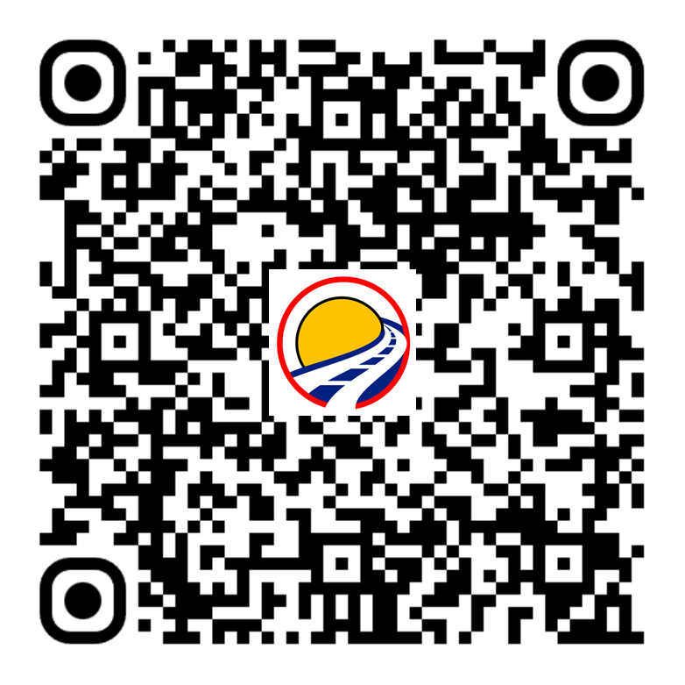
Ramp Up Engagement Tactics
Email Marketing: Send regular newsletters to keep your brand top-of-mind, featuring menu updates, special events, and exclusive offers only for the email list.
Social Media Campaigns: Utilize platforms like Instagram and Facebook to post engaging content that highlights your seasonal offerings and behind-the-scenes action.
Stay Engaged: Social Media is a two-way conversation. Ask questions, share personal stories, behind the scenes posts, etc. Build excitement for the reopening.
Branding & Marketing
Master Class
Collect Guest Contact Info Year Round

Slide 11
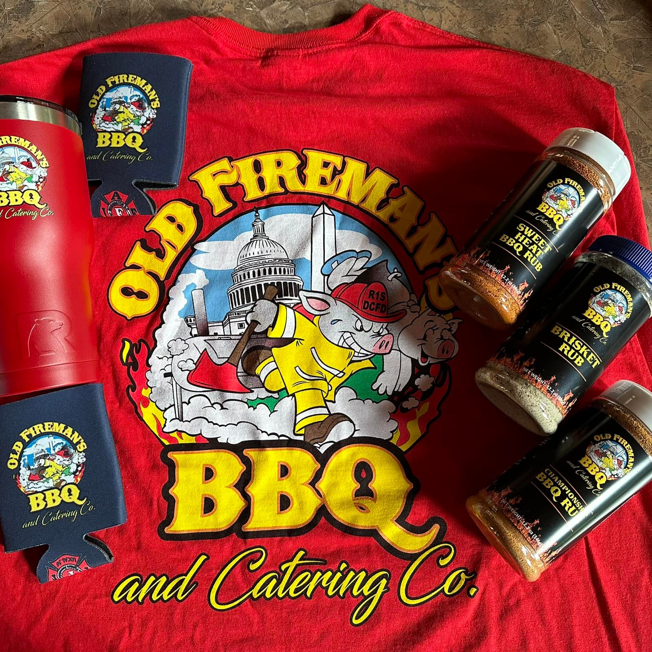
More Revenue Streams
Catering Services: Market your food truck as a perfect solution for holiday parties, corporate events, and private gatherings.
Merchandising: Sell branded merchandise such as apparel, sauces, or recipe books.

Slide 12
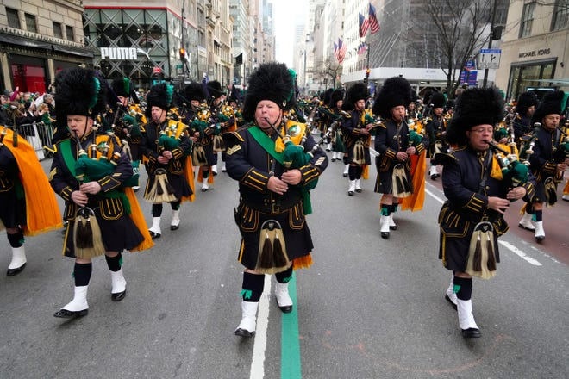
Collaborate and Partner
Local Businesses, Events and other Food Trucks: Partner with local businesses for pop-ups or collaborate on special events to reach new guests.
Sponsorships: Engage with community events that align with your brand for increased visibility. Fun Raisers, Parades, Charity Events.
Themed Events: Host themed food events that resonate with the season, such as a Halloween trick-or-treat or a Thanksgiving feast.
Community Involvement: Participate in local community events to keep your truck/business active and engaging during slow months.
Fundraising Events

Slide 13
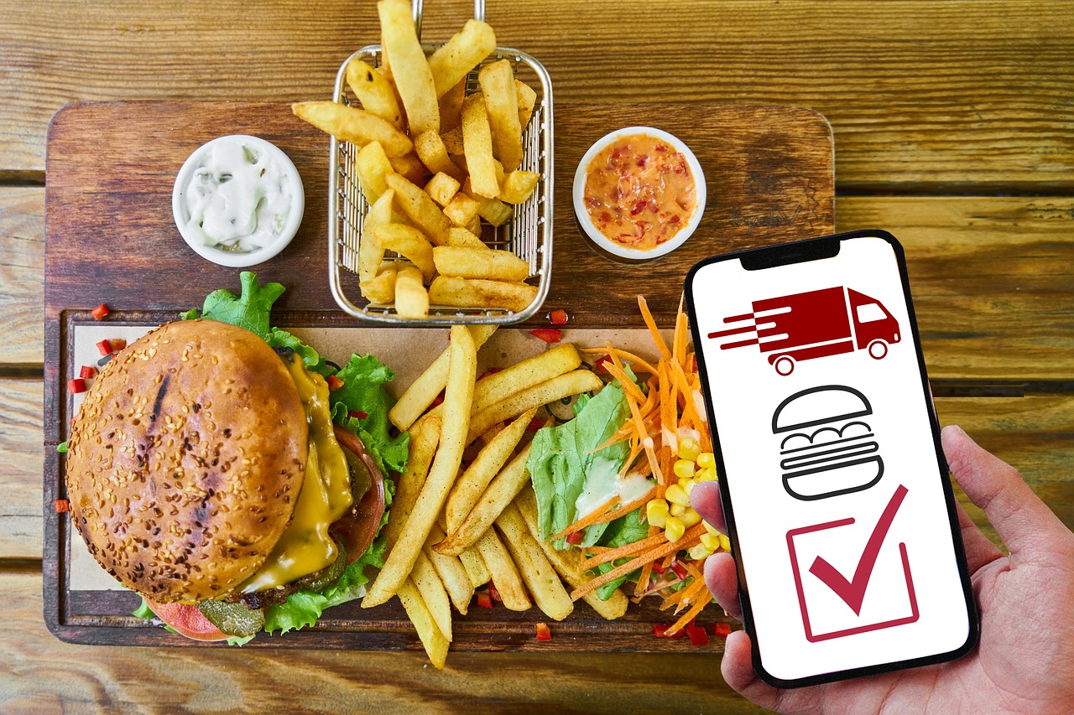
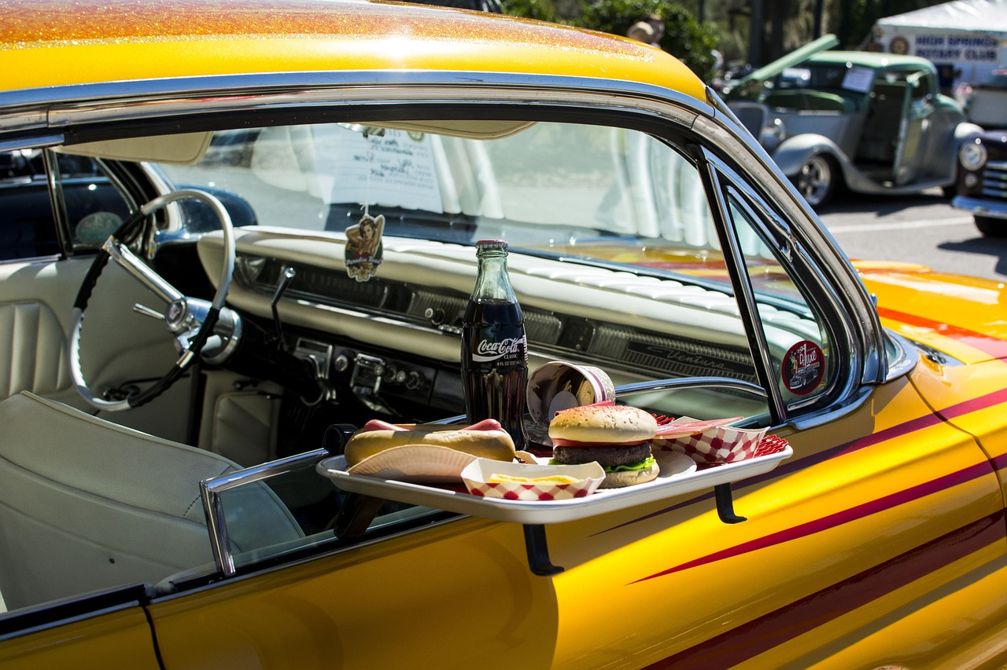
Optimize Your Online Presence
Website: Ensure your website is updated with your winter schedule, location updates, and current / planned menu.
Online Ordering: Set up or enhance online ordering systems to make it easy for guests to purchase despite colder weather. Deliver to vehicle when the guest arrives.
Explore Delivery: Internal delivery staff saves money while 3rd party is always an option.

Slide 14
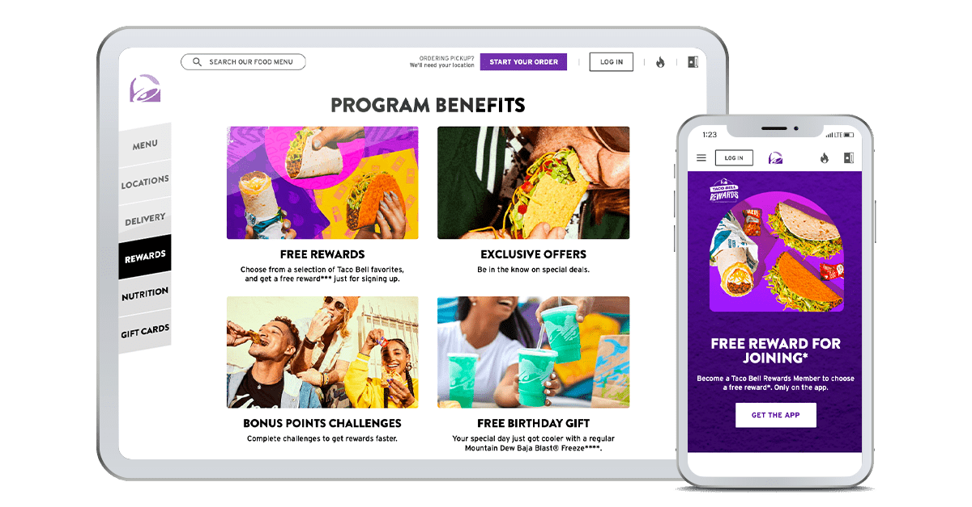
Loyalty Program
Loyalty Offers: Develop a loyalty program that rewards repeat guests with discounts, freebies, or early access to new items. Stay in touch with Loyalty Participants in off season. Allow them to earn points / punches for helping promote your business on social media
Guest Appreciation: Host guest appreciation events or offer special discounts to your most loyal fans.

Slide 15
Monitor Results and Adapt
Track Metrics: Monitor sales data, customer engagement, and overall performance of marketing campaigns.
Adapt Strategies: Be prepared to tweak your strategy based on what’s working or not, ensuring agility in your marketing approach.
KPIs

Slide 16
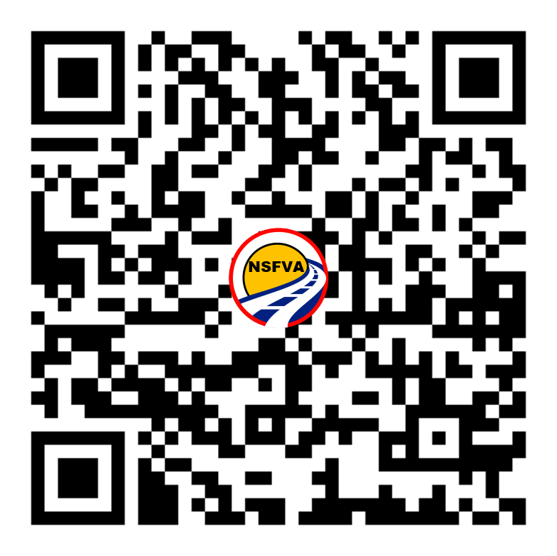
Q A
&

