Slide 1
NATIONAL
STREET FOOD
VENDORS
ASSOCIATION
One Voice,
One License

Slide 2
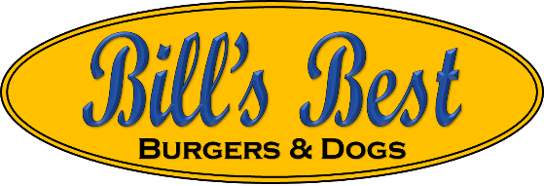
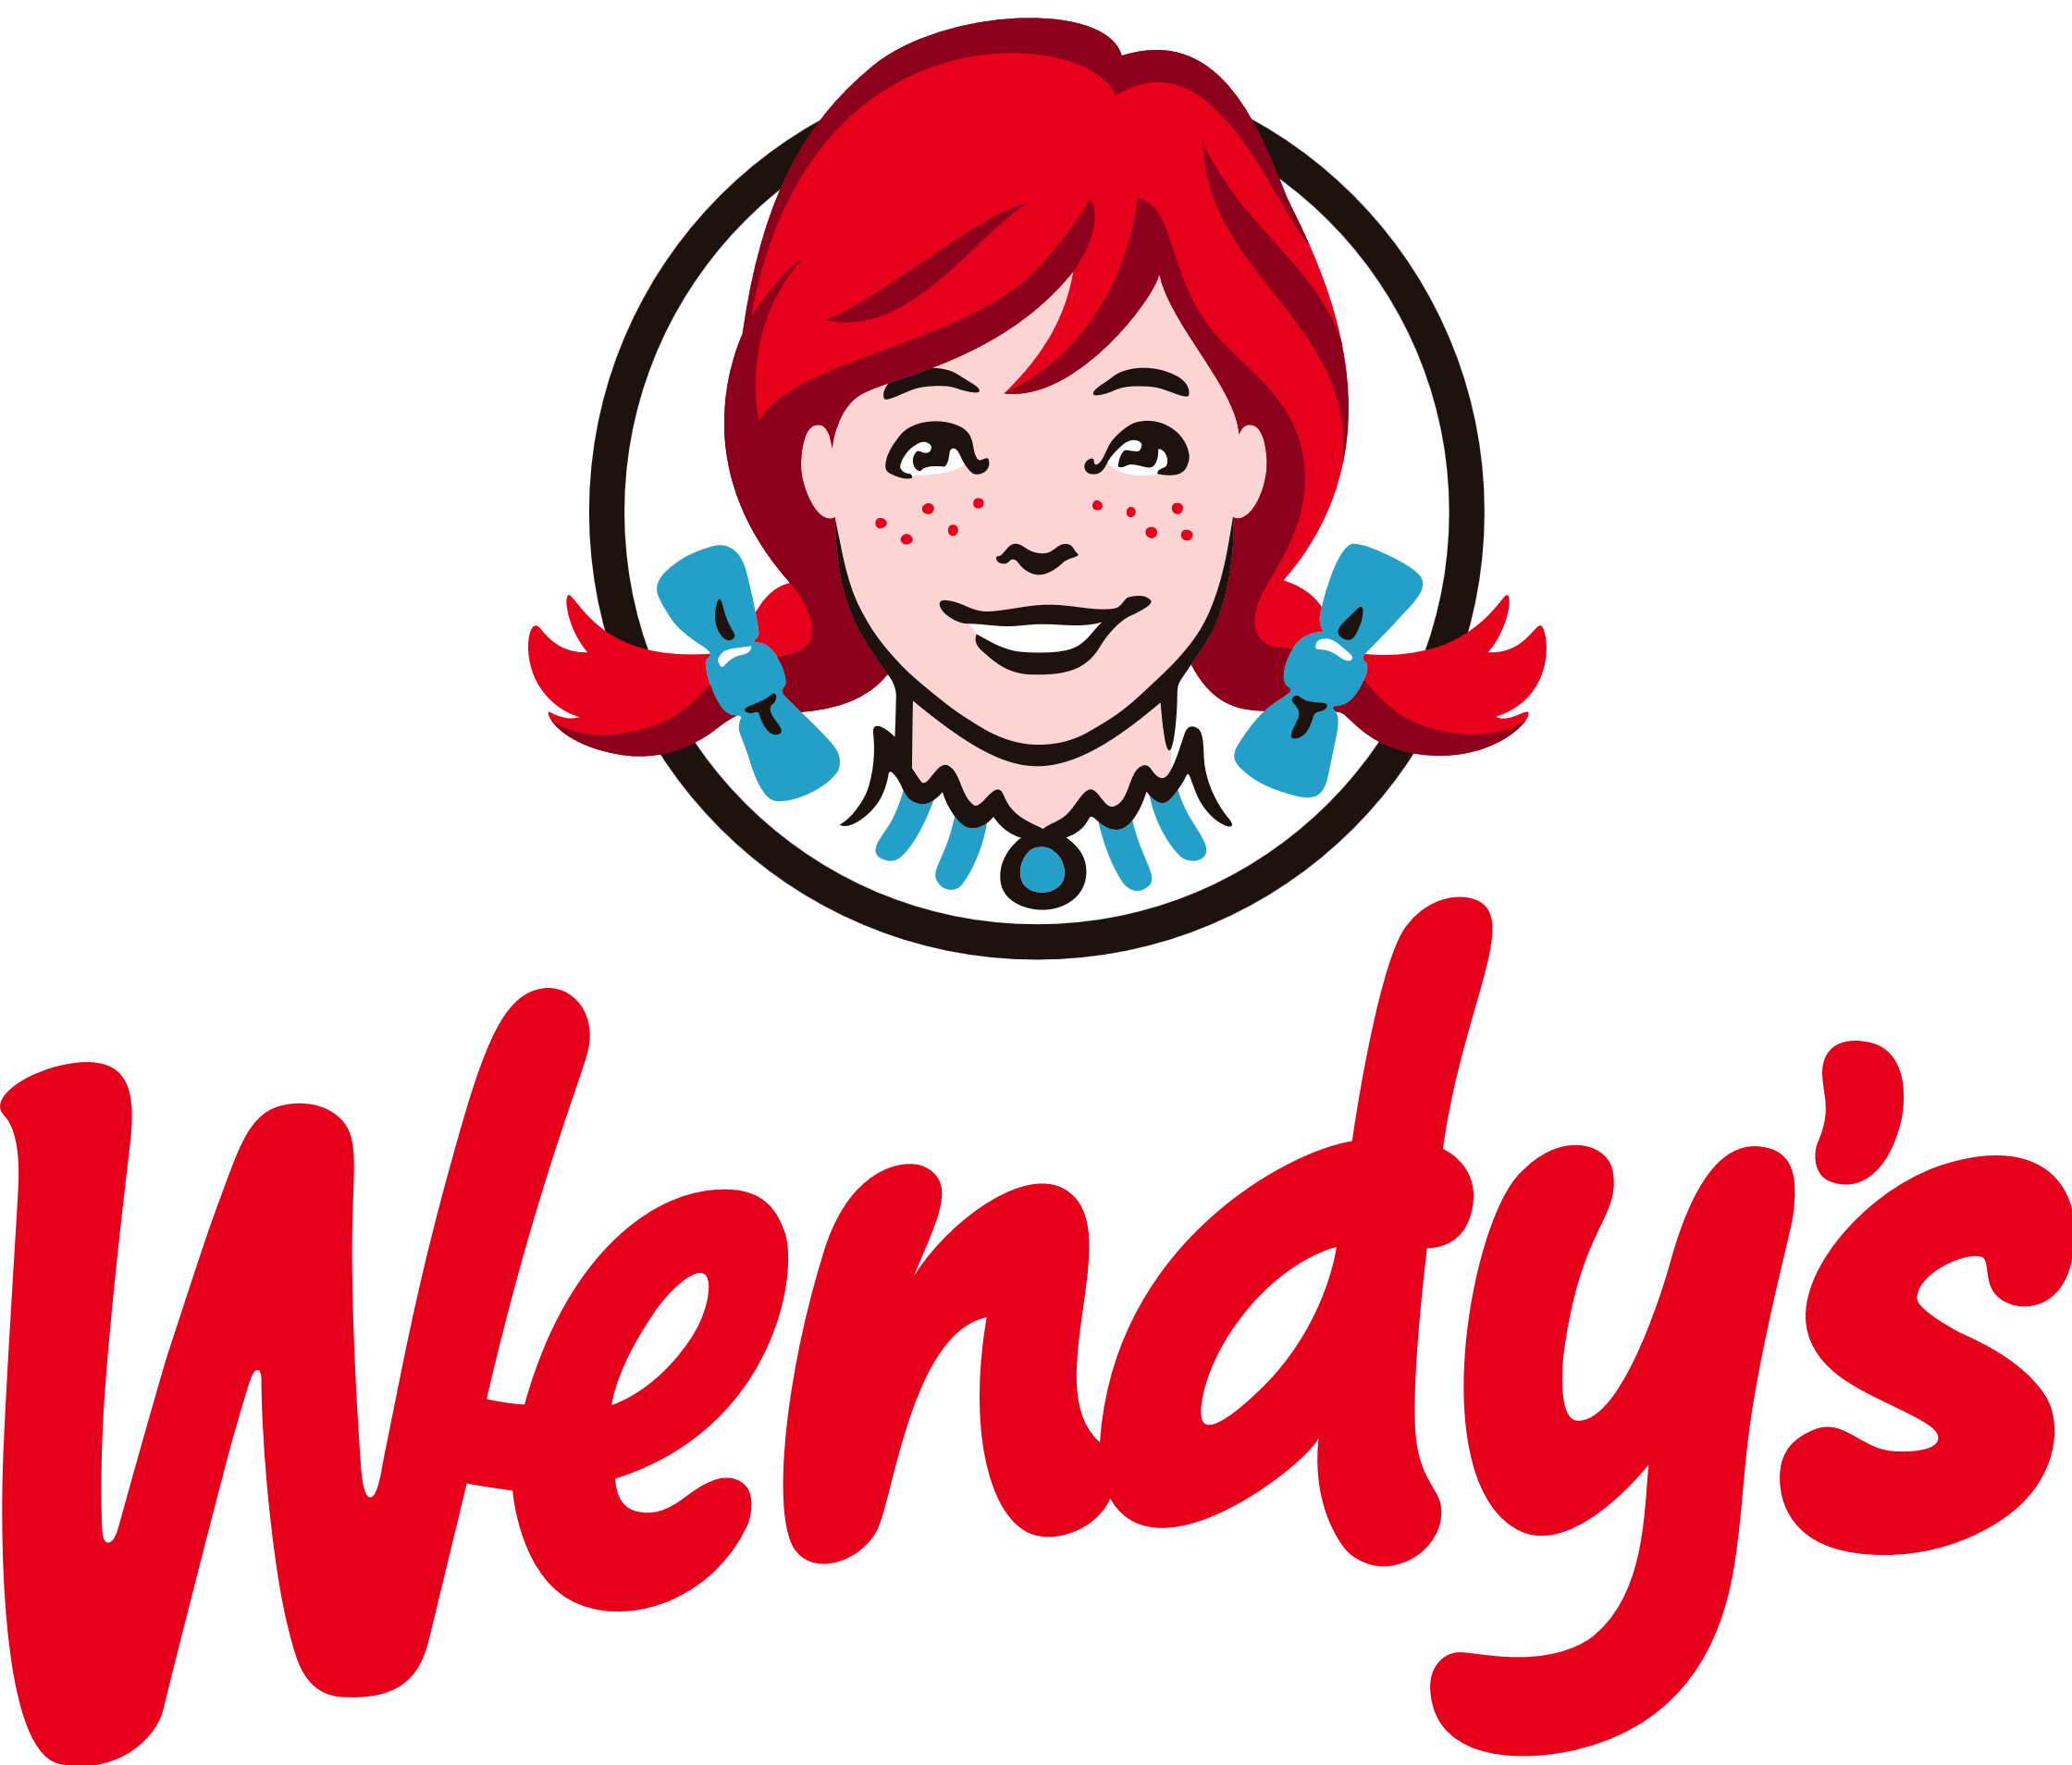
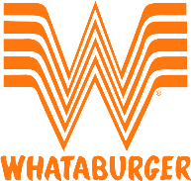
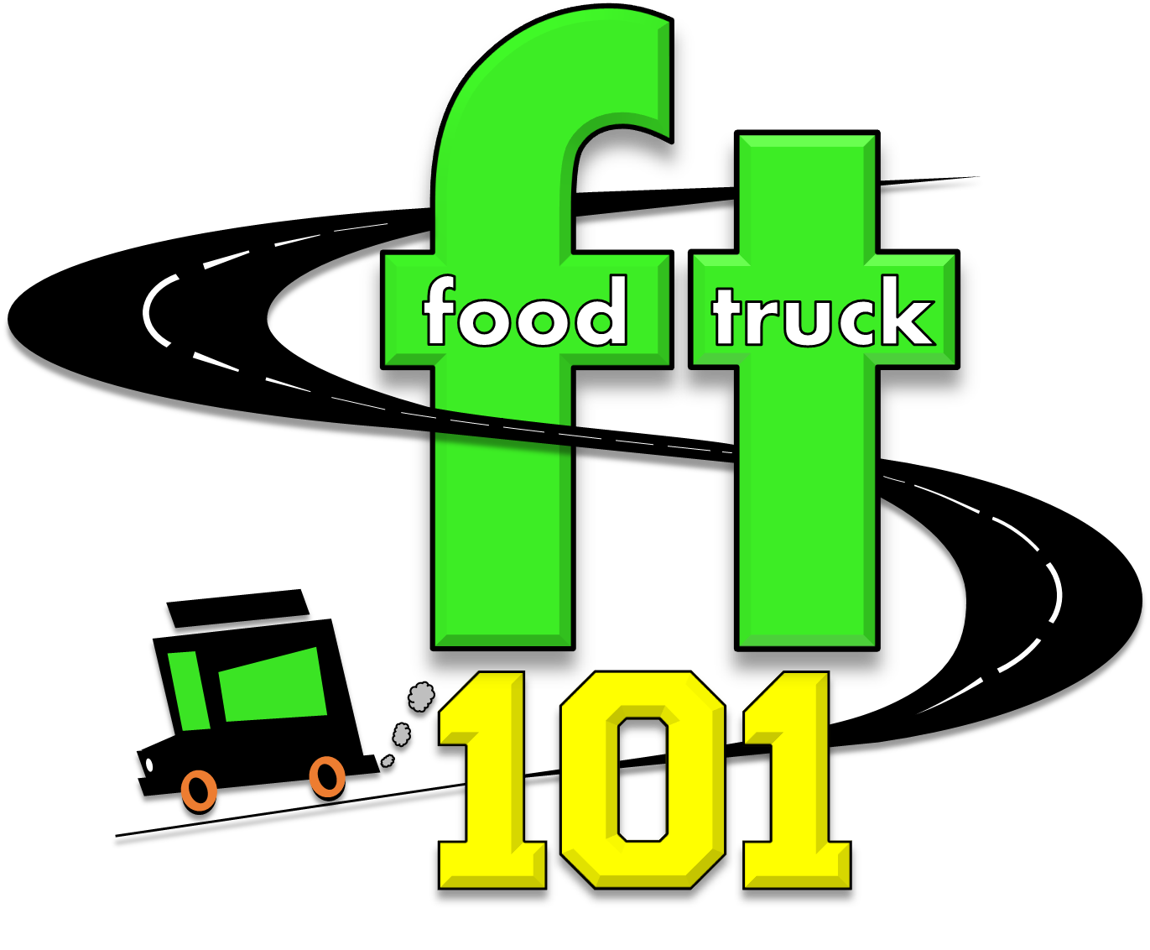
Street vendor
Author
Corporate Trainer
Executive Director
Bill Moore

Slide 3
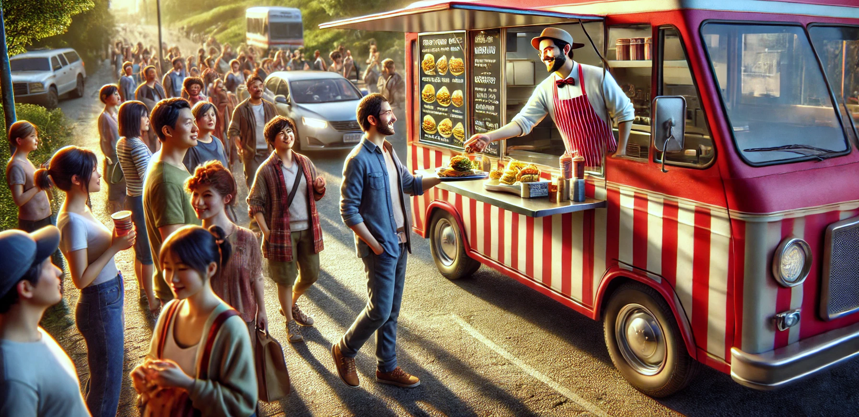

Slide 4
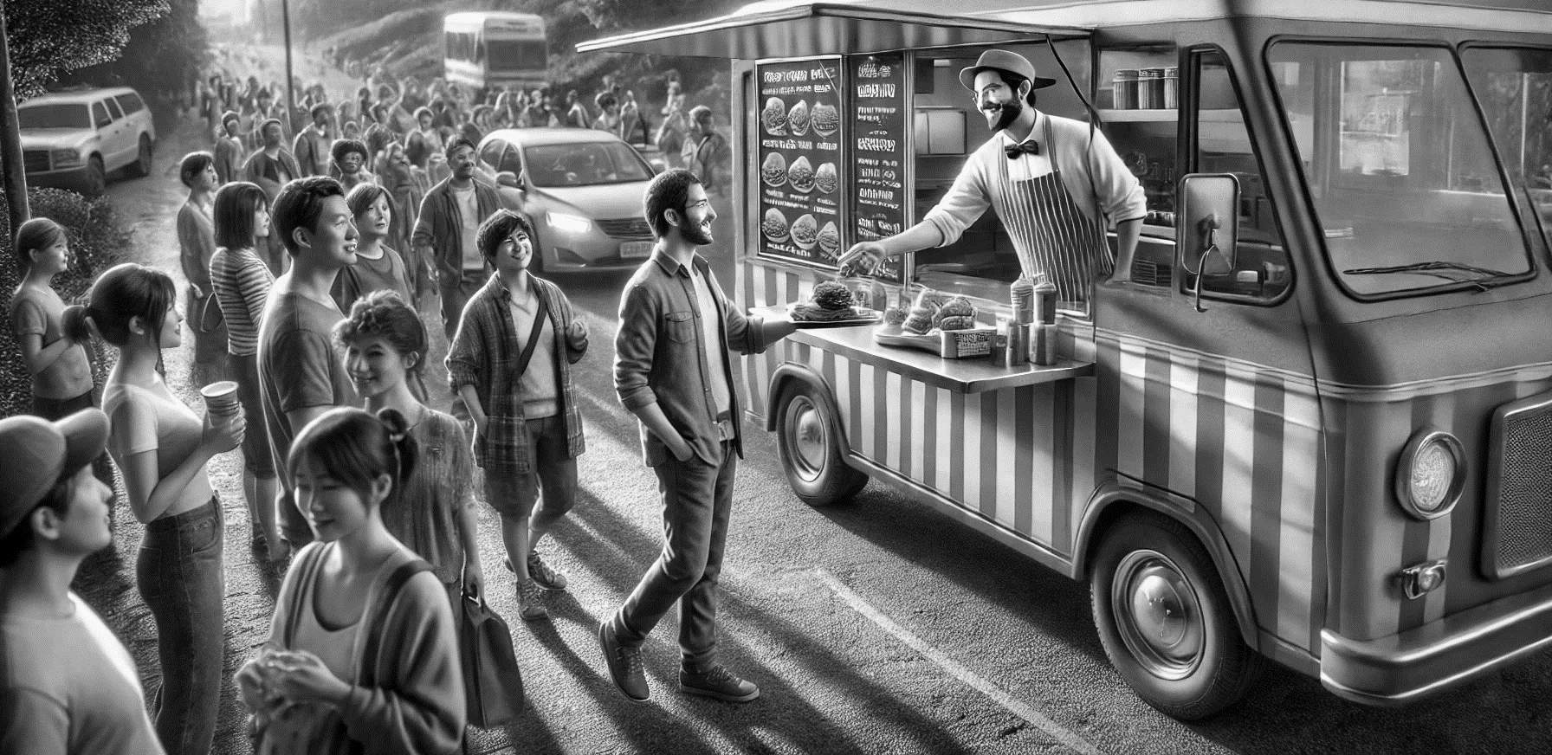

Slide 5
Houston $1023
Harris $258
Fort Bend $258
Pasadena $430
Pearland $200

Slide 6
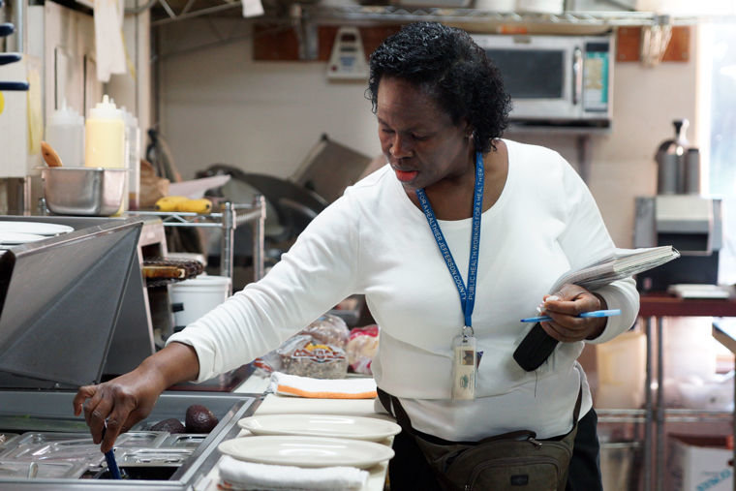
Spend the time educating and preventing the illegal vendors. The ones more likely to make folks sick.
Inspecting an already permitted food truck is just wasted time!

Slide 7
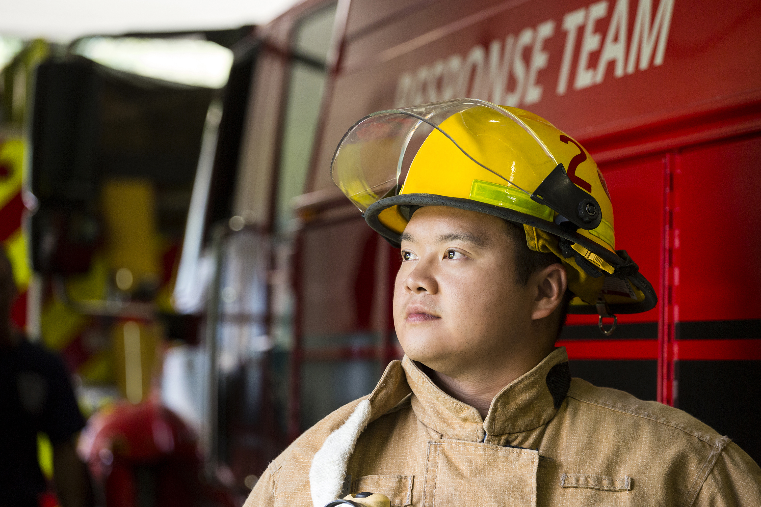
Don’t Forget
fire inspections
Money & Time Waste
Yours and the government

Slide 8
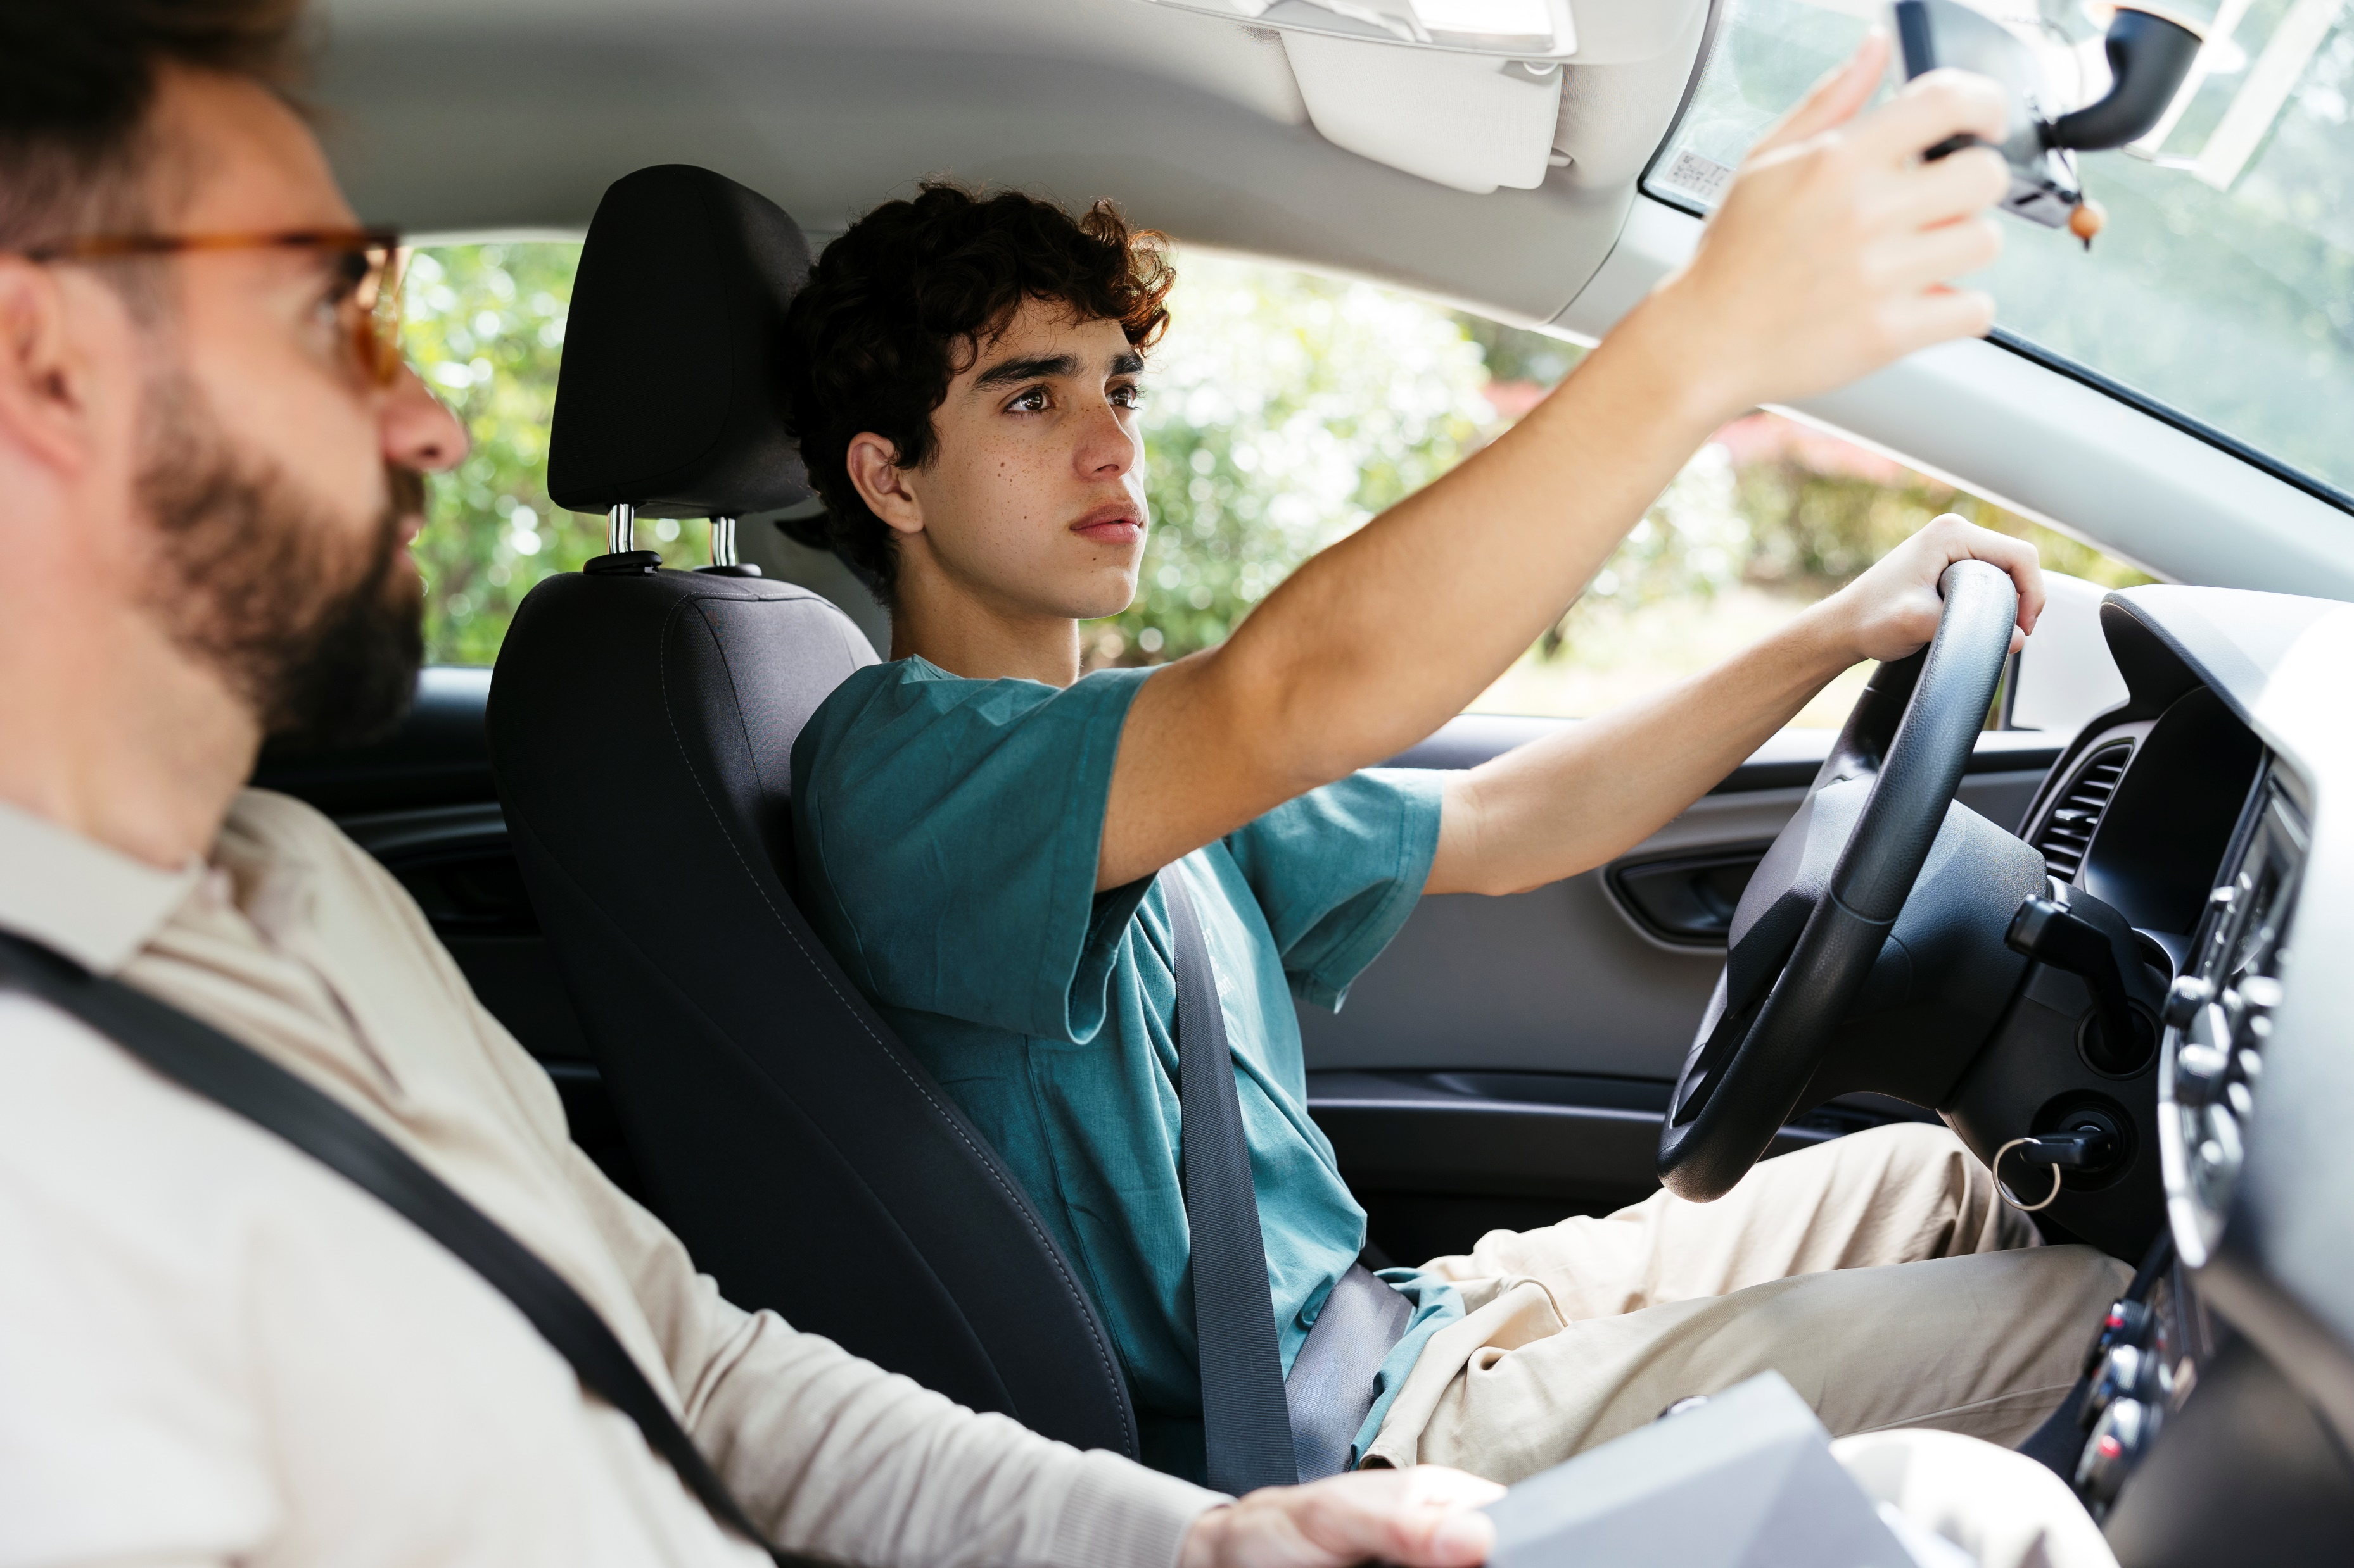
Do you have a
driver’s License?

Slide 9
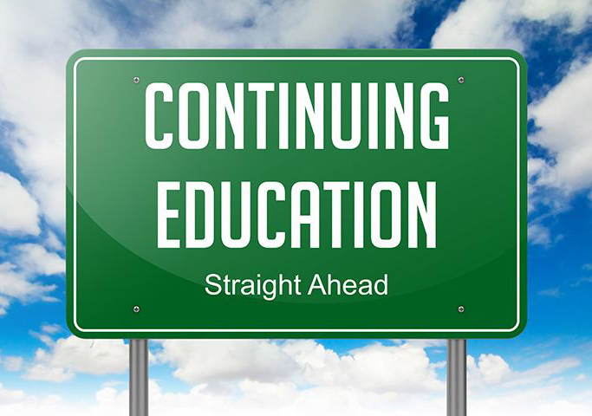
Renewal Process is just sending money!

Slide 10
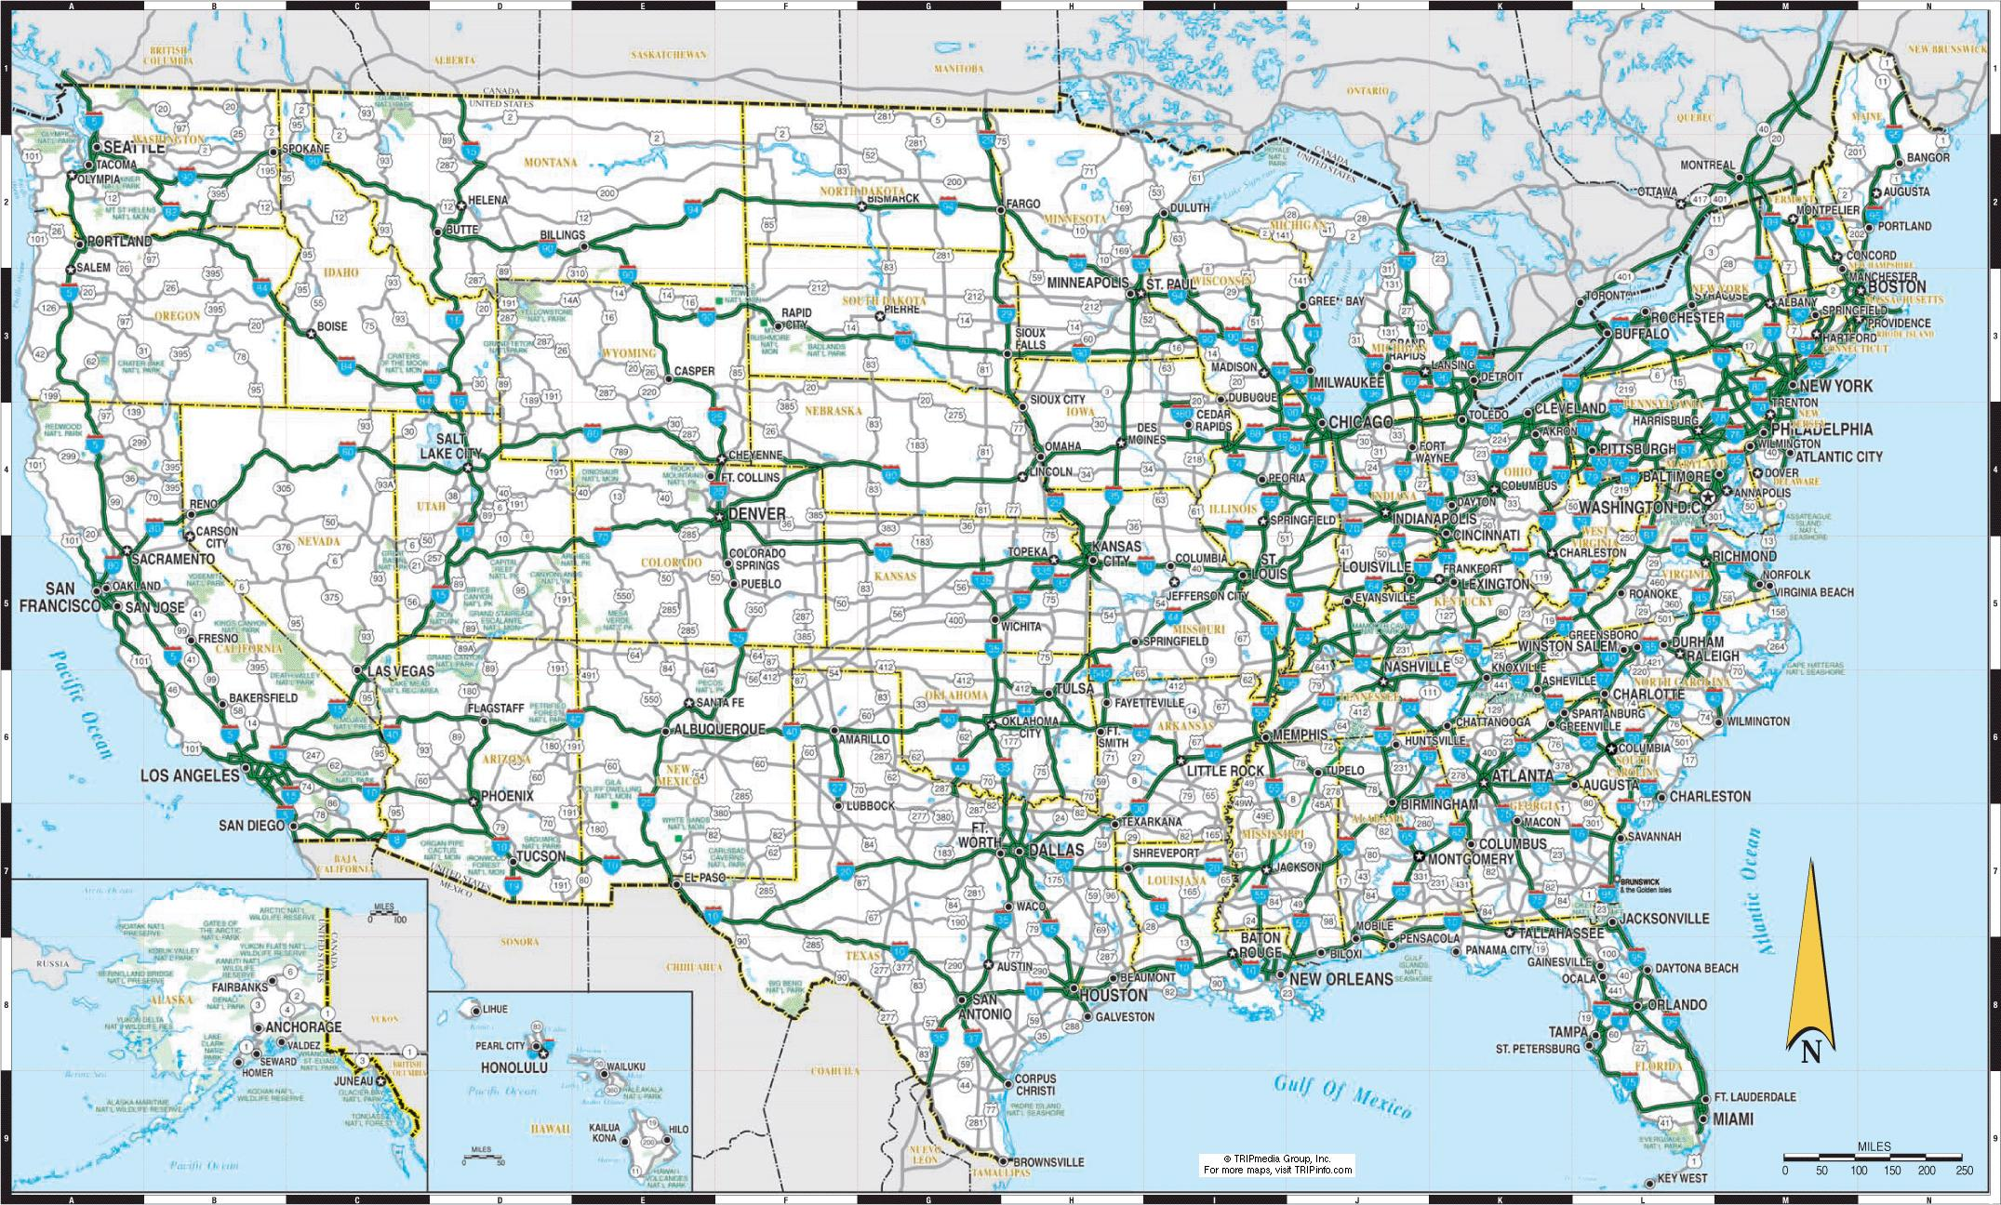
Drive anywhere anytime!

Slide 11
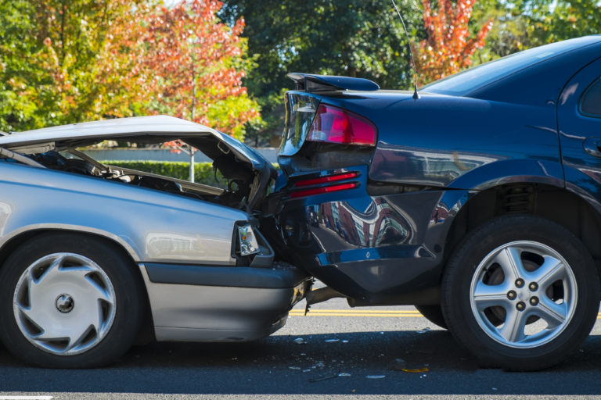
Number of People Killed in Auto Accidents Annually
42,514 *2022

Slide 12
Number Food Borne Illness Deaths
3,000 *CDC Estimate
Across all foods not just food trucks

Slide 13
How do we fix this and other issues facing our industry?

Slide 14
Speak with
ONE VOICE

Slide 15
Why Food Truck Owners MUST speak with ONE VOICE
Clarity and Strength: When food truck owners present a unified message, it’s clear and strong. It’s like a chorus singing in harmony. A clear, unified message is hard to ignore and shows that the we are organized and serious about our concerns.

Slide 16
Why Food Truck Owners MUST speak with ONE VOICE
Focus on Key Issues: It is easy for the main issues to get lost among many different viewpoints. By coming together and agreeing on the most important issues, food truck owners can ensure that our key concerns are addressed. This focus helps streamline our efforts and makes our advocacy more effective.

Slide 17
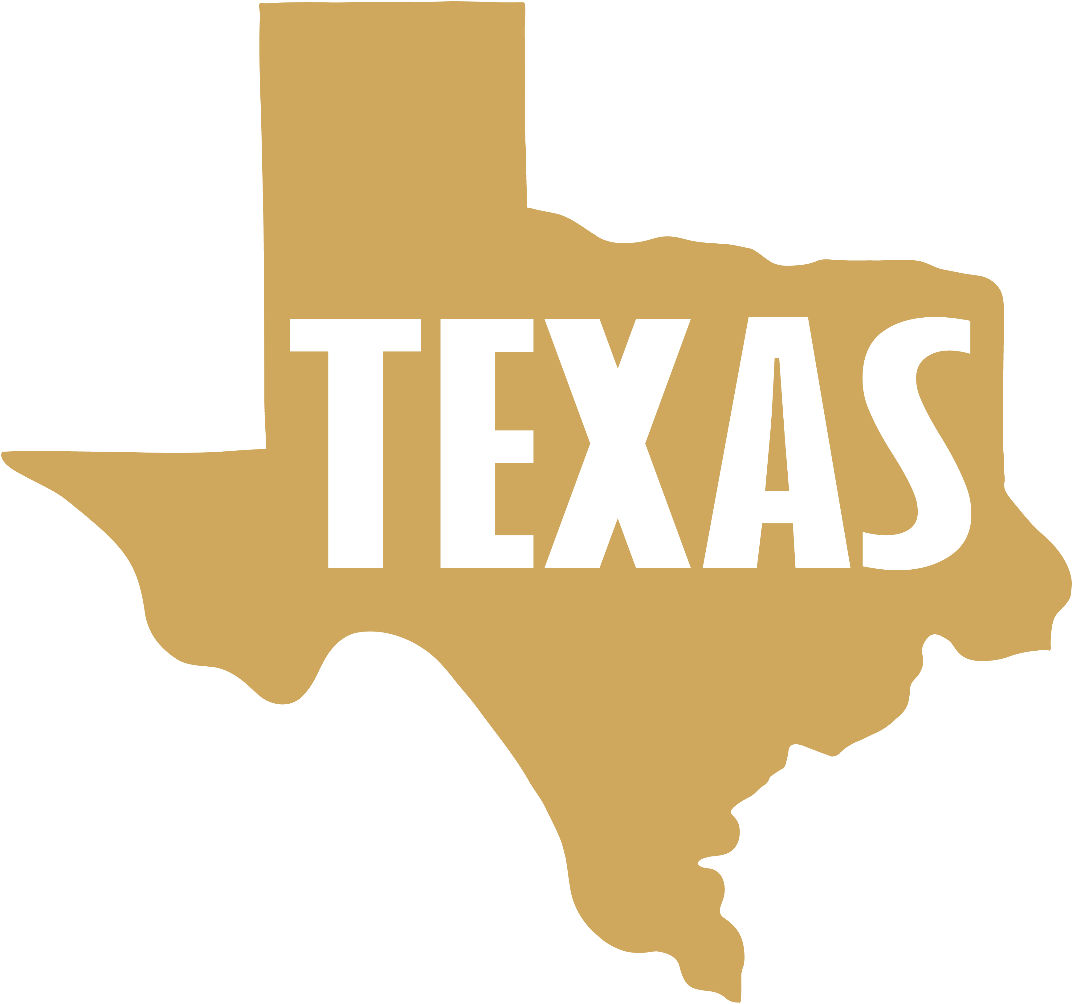
Why Food Truck Owners MUST speak with ONE VOICE
Influence and Impact: Decision-makers, like city councils or legislators, are more likely to listen and act when they see a large, united group. If food truck owners are all asking for the same change—such as reciprocal licensing across cities—they demonstrate a significant need and potential benefit, making it more compelling for officials to support their cause and change the laws.

Slide 18
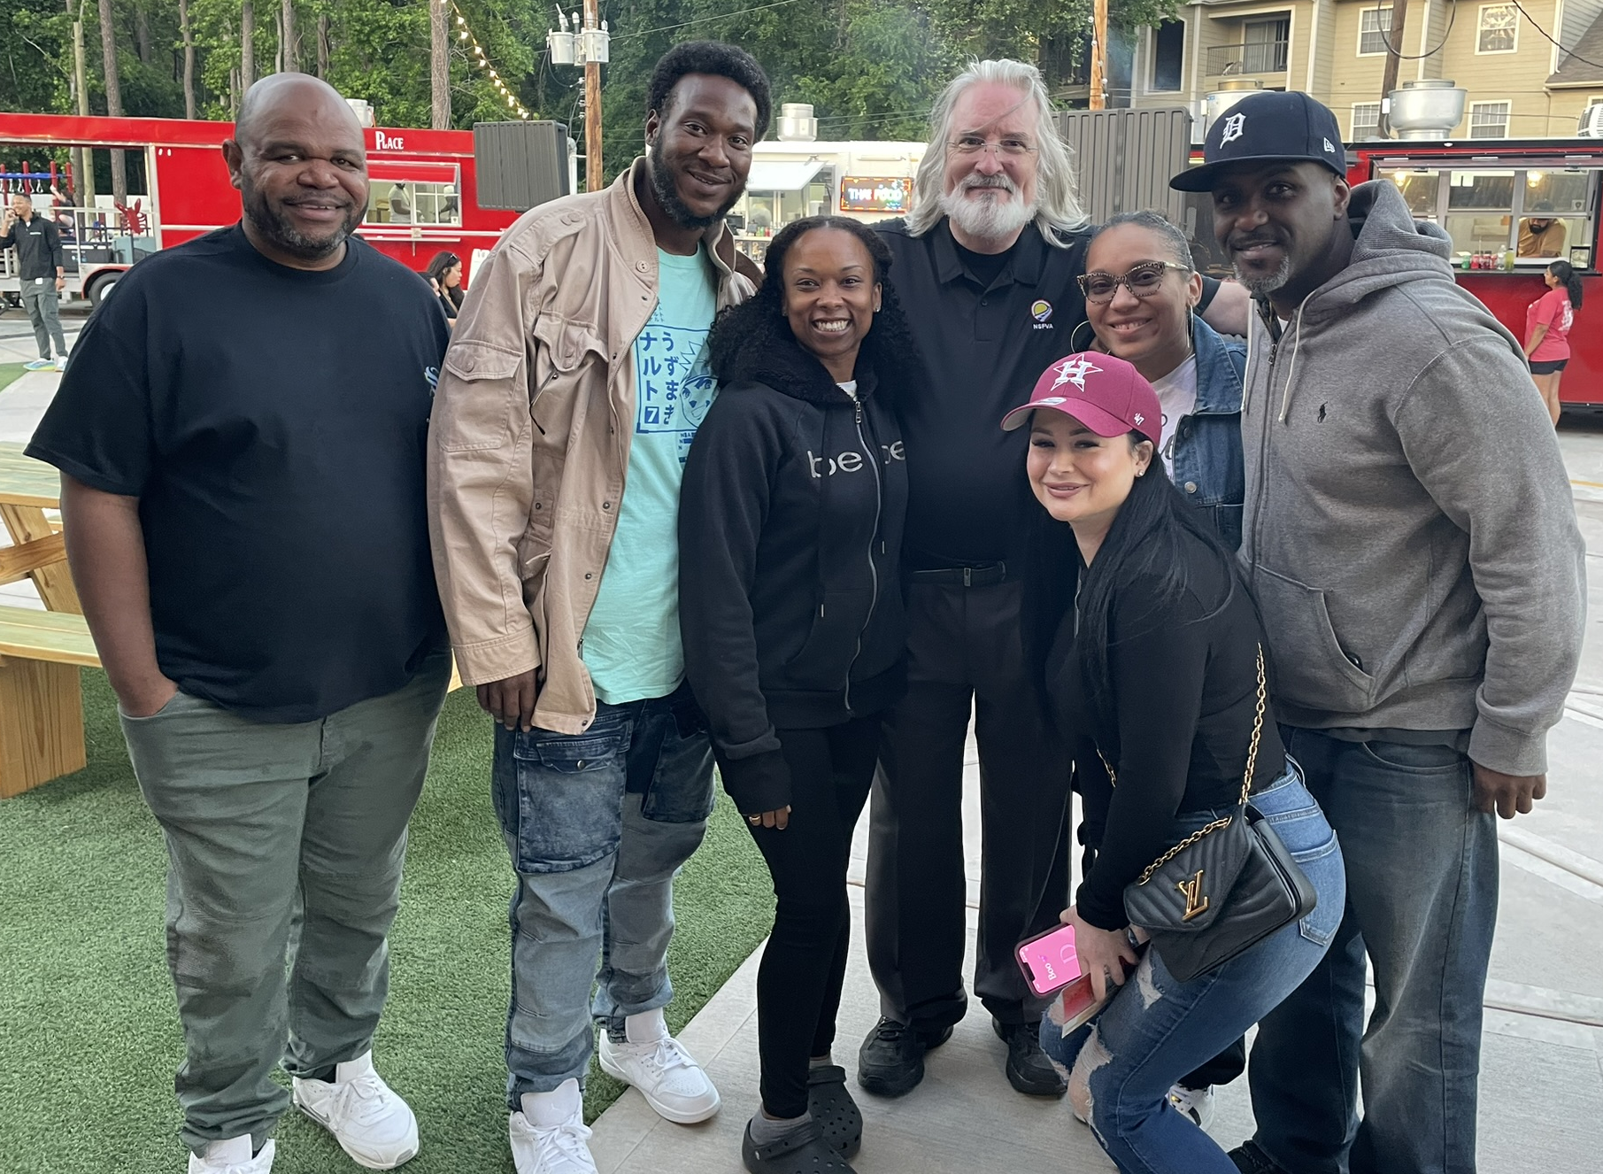
Why Food Truck Owners MUST speak with ONE VOICE
Building a Stronger Community: Speaking with one voice fosters a sense of community and solidarity among food truck owners. It shows that we are not just individual businesses, but part of a larger movement working towards common goals. This unity can lead to more support, better resources, and a stronger network.

Slide 19
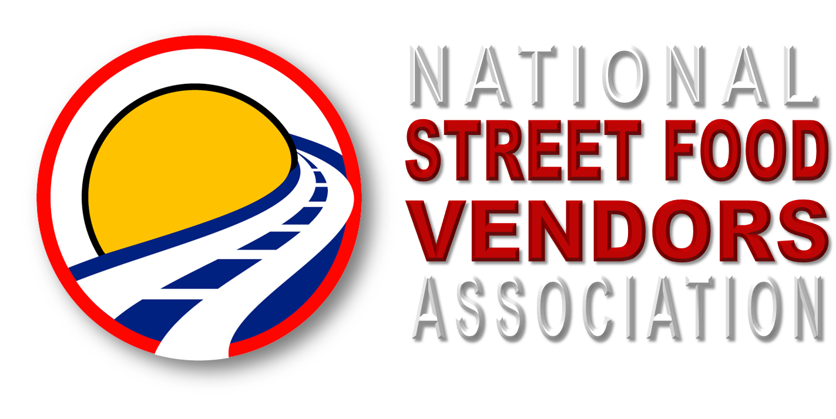

Slide 20
Advocacy
Representation at Local, State, & National Levels
Ensuring Your Voice is Heard
Creating Favorable Policies and Regulations

Slide 21
Networking
Diverse Community of Food Truck Owners, Industry Experts, and Suppliers
Building Relationships, Sharing Experiences, and Collaborating

Slide 22
Education
Comprehensive Educational Resources
Staying Ahead of Industry Trends
Guidance from Experts

Slide 23
Promotion
Highlighting Member Businesses on Our Website
Leveraging Social Media Platforms
Showcasing at National Events

Slide 24
Standards
Establish & Reward High Standards
Ensuring Excellence from Service Partners
Demonstrate a Commitment to Quality

Slide 25
Community
Meaningful Advice and Support
Sharing Success Stories
Building a Collaborative National Community

Slide 26
QR Code
Become a Founding Member today!

Slide 27
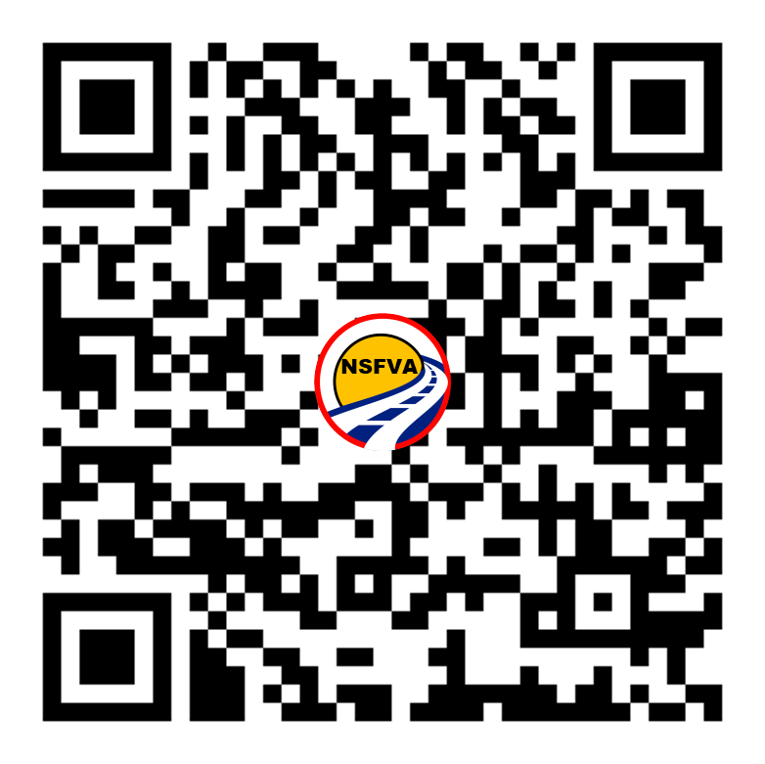
Q A
&

